Slide 1
HOW TO MINIMISE PRODUCTION COSTS
AT THE PRELIMINARY DESIGN STAGE
Philippe RIGO
ANAST, Dept. of Naval Architecture,
University of Liege,
Belgium
(ph.rigo@ulg.ac.be)
(National Funds of Scientific Research of Belgium)

Slide 2
THE COST MODULE &
THE OBJECTIVE FUNCTION
Global construction costs can be subdivided into three categories:
  (a) Cost of raw materials,
  (b) Labour costs,
  (c) Overhead costs

Slide 3
Cost of raw materials
The evaluation of material costs consists in
- quantifying volumes required for construction,
- obtaining prices from suppliers and subcontractors.
This task seems simple, but contains numerous uncertainties as the quantity assessment (number of parts) that is improved with the project progress.
Scrap parts constitute an important unknown, especially at the beginning of a project.
A classic evaluation is 5 to 10%, but the percentage can be higher, depending on the zone studied (aft and fore, machinery area) and the selected design details (bracket shape, slot type, etc.).

Slide 4
LABOUR COSTS
Instead of using empirical formulations,
the best alternative to evaluate labour costs is an analytic assessment.
Such an approach requires knowing
the work time required for each standard labour task associated with a workstation
the subdivision by stations of the entire construction process.
All operations should be included.

Slide 5
ANALYTIC EVALUATION
OF THE CONSTRUCTION COSTS
The real construction cost of a structure can be expressed by
Total Cost = Material costs + Labor Costs + Overhead Costs (1)
TC = MatC + LabC + OvC
The purpose is to obtain a relative and objective comparison, on basis of cost, of the successive designs resulting from the optimisation process.
So, the absolute cost is not needed.
Only the two first terms (Material costs + Labor Costs) are significant.

Slide 6
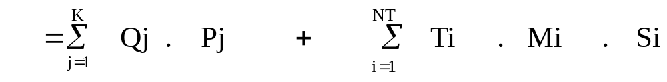
TC = MatC + LabC (Eq.2)
Number Euro/unit Man-hours Task Euro/m-h
of units per task frequency
where:
j = reference number of a given material, that is, 1 ton of steel plate,
1 m long of angle bar of 60x60x5, etc.
K = number of different materials, j=1,K,
Qj = expected quantity of the j material,
Pj = unit price of the j material (Euro/unit),
NT = number of different standard tasks,
i = reference number of a given task, i=1,NT,
Ti = required working load for the i standard task (man-hours),
Mi = number of times that the Ti task happens (frequency),
Si = hourly labour cost (Euro/man-hour) of a person doing the i standard task.

Slide 7
BREAKDOWN OF THE CONSTRUCTION
Ship --> Blocs
Blocs --> Modules
Modules --> Panels and Sub-Panels
Panels --> Elements (plate, stiffener)
ANAST ULg

Slide 8
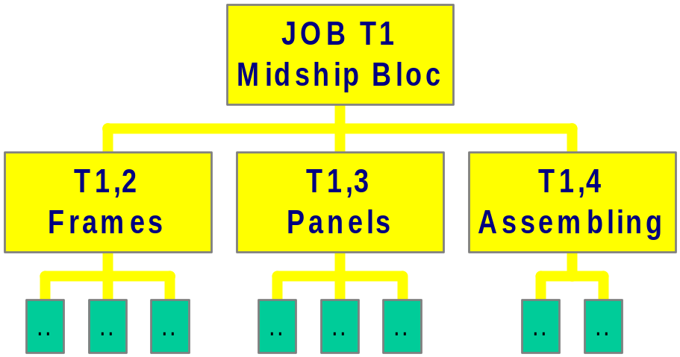
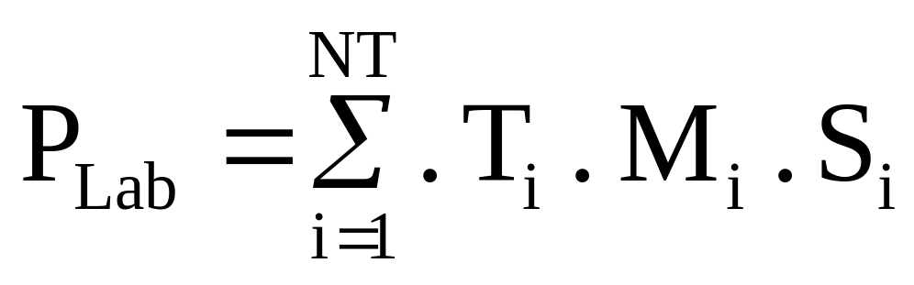
LABOUR COSTS
NT = Number of different types of standard jobs (i=1,NT),
T_{i} = Labour load of a standard job (i) ; (man-hours),
M_{i} = Number of time the job (i) must be repeated ,
S_{i} = Unitary labour cost of a standard job (i) ; (FB/h-h)

Slide 9
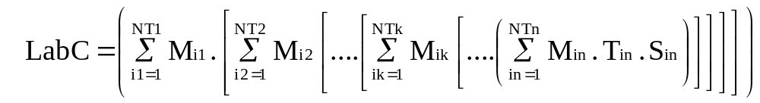
Eq.2 is a condensed equation of a more general one in which the description of tasks, sub-tasks and the elementary tasks explicitly appears, that is Eq.3:
(Eq.3)
where k is the hierarchical level of the task,
k = 1 superior level (block),
k =2,3,..., intermediate levels (panels,...),
k = n elementary level.

Slide 10
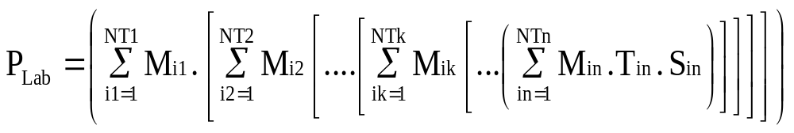
LABOUR COSTS
NT = Number of different types of standard jobs (i=1,NT),
T_{i} = Labour load of a standard job (i) ; (man-hours),
M_{i} = Number of time the job (i) must be repeated ,
S_{i} = Unitary labour cost of a standard job (i) ; (FB/h-h)

Slide 11

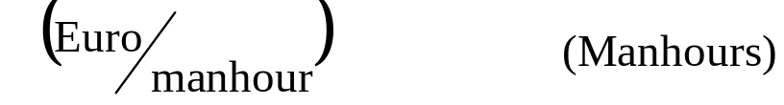
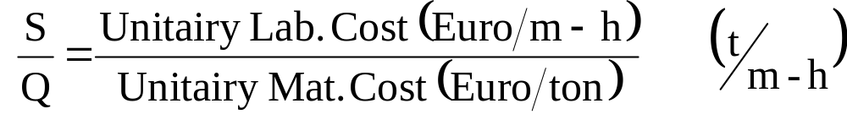
NORMALIZED COST
Using the "Equivalent Weight Concept ”, the Total Cost (TC, Eq. 4) can be written with Eq. 5.
TC = Total Cost (Euro),
TC = [Unitary Mat. Cost] . [Weight] + [Unitary Lab. Cost] . [Working Load] (4)
TC = [Unitary Mat. Cost] . [EQP] (Euro) (5)
where:
EQP = Mat. Weight + k. WLoad (tons),
k = (6)
Wload = the global working load (man-hours).

Slide 12
NORMALIZED COST
This Equivalent Weight (EQP) allows easy evaluation of the total cost for a series of material unit prices (Q) and labour (S), thus permitting a comparison between countries where the k coefficient varies.
In Europe, the k coefficient varies between 0.03 and 0.10 t/man-hour.
  In spite of what the k coefficient units (t/m-h) could lead us to believe, the k coefficient is absolutely not linked to productivity, but only to the cost of living.

Slide 13
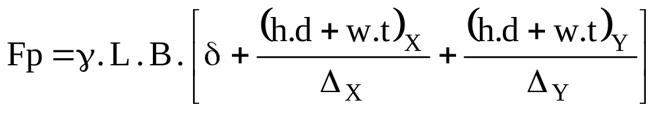
MODELLING OF THE OBJECTIVE FUNCTION
The cost objective function or the weight objective function can be used.
The weight objective function is in fact a simplified form of the cost objective function.
It is an explicit function of the design variables :
  plate thickness (δ),
  spacing (Δ_{x}, Δ_{y})
  dimensions of the longitudinal (h,d,w,t)_{X}.
  dimensions of the frame (h,d,w,t)_{Y}.
Thus, Fp, the weight objective function can be written for an orthotropic stiffened panel as:
[7]

Slide 14
- COST MODEL of L.B.R.-5 -
COST = Fct { δ } { h,d,w,t (long.) } { Δ_{long} } { h,d,w,t (trans.) }
{ Δ_{trans} }
ANAST ULg

Slide 15
where:
L (m) = length of the panel according to the X co-ordinate,
B (m) = breadth of the panel according to the Y co-ordinate,
δ = plate thickness (m),
γ = specific weight (N/m³),
(h,d,w,t)_{X} = dimensions of web and flange of the long. stiffeners fitted along X,
(h,d,w,t)_{Y} = dimensions of web and flange of the transverse frames fitted along Y,
Δ_{X} = spacing between two longitudinals (stiffeners) fitted along X,
Δ_{Y} = spacing between two transverse frames fitted along Y.

Slide 16
COST MODEL
The cost model includes three components (Eq.8):
FC = F_{MAT} + F_{CONS} + F_{LAB} (€) (8)
where:
FC: global cost function (in Euros);
F_{MAT}: cost of basic materials (plates, bars, etc.);
F_{CONS}: cost of consumables necessary for the construction process (energy, welding materials, etc.);
F_{LAB}: cost of labour used for the building of the entire structure.

Slide 17
a) COST OF MATERIALS: F_{MAT}
The cost of materials is directly derived from the weight function.
Each term is multiplied by the relevant C_{i} unitary material cost (plate, bulb profile, etc.).
(Eq 9)

Slide 18
where:
C₁ = cost per kg of a plate d mm thick,
C₂ = cost per kg of the longitudinals/stiffeners,
C₃ = cost per kg of the transverse frames,
DW₂ = corrective factor (ratio of C₂) of the longitudinals/stiffeners for additional weight,
DW₃ = corrective factor (ratio of C₃) of the transverse frames for additional weight.
DW₂ and DW₃ are used to adjust the member weight, of respectively, the longitudinals and frames, to consider the extra weight induced by brackets (TAP), local stiffening as flat bars to stiffen high web-frames (see Figure 2).

Slide 19
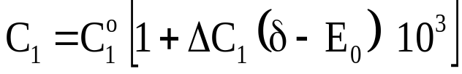


To consider variation of unitary price (€/kg) of the plates according to their thickness, the C₁, C₂ and C₃ parameters are defined as follows:
(€/kg) for the plates [10a]
(€/kg) for longitudinal members [10b]
(€/kg) for frames and transverse members [10c]

Slide 20
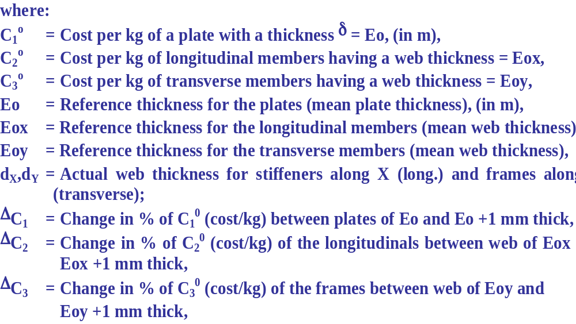

Slide 21
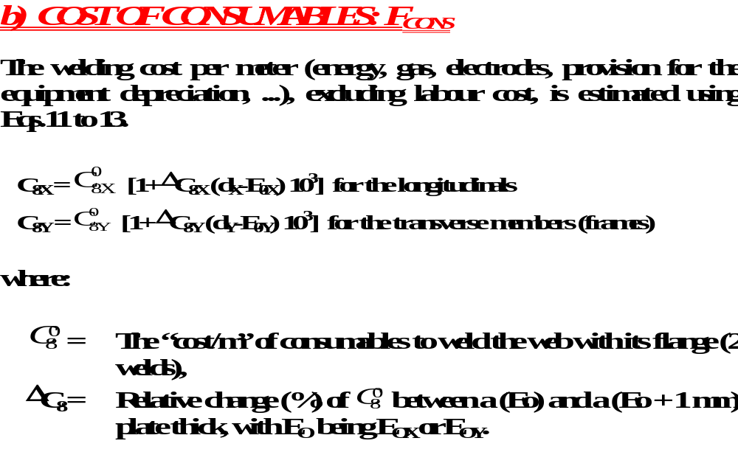

Slide 22
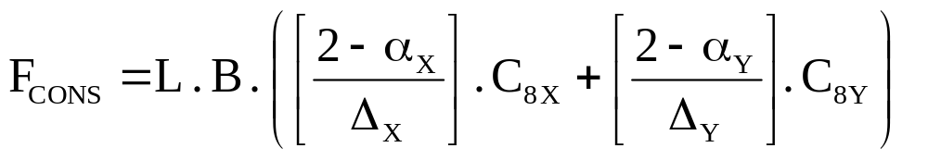

Then the consumable cost is:
(Euro) [13]
where:
α_{X}, α_{Y} = 0, if the members are manufactured on the yard from standard plates. In this case, the welding costs to weld the flange and the web are added;
α_{X}, α_{Y} = 1, if the members are standard profiled members [IPE, HEA, HP bulb profile,…];
Coefficients and ΔC₈ are defined either with the WELDCOST program(used to evaluate welding costs (E.S.A.B. S.A.) for both semiautomatic welding (GMAW) and manual welding) or using the shipyard database.

Slide 23
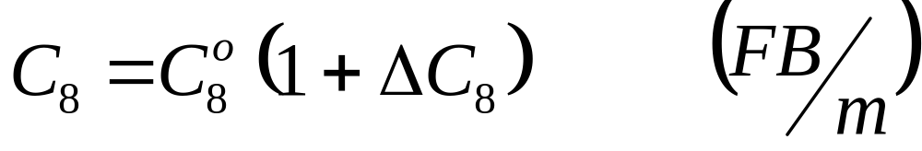
- WELDING MATERIAL COST -
MANUAL
SEMI-AUTOMATIC
WELDCOST - E.S.A.B. SA
(CEWAC)
Plate Thickness

Slide 24
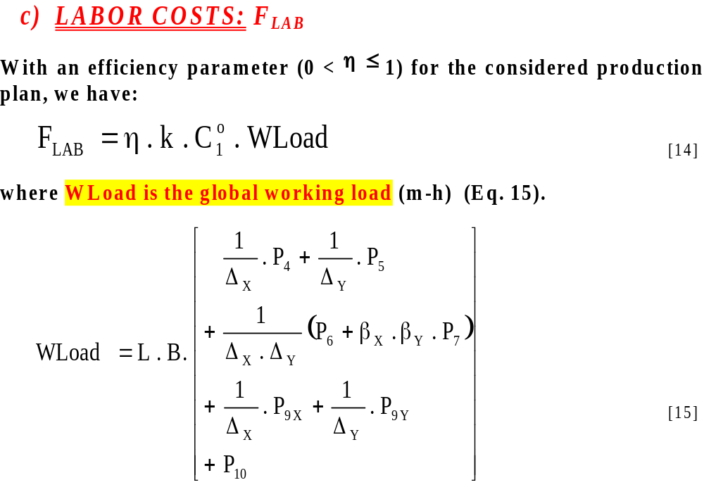

Slide 25
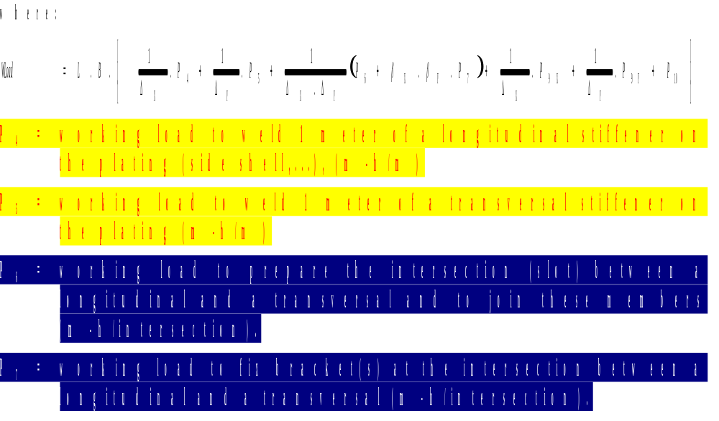

Slide 26
- Labour Cost - WELDING -
WELDCOST - E.S.A.B. SA
(CEWAC)
Labour Load
(Min/meter)
MANUAL
SEMI-AUTOMATIC
Plate Thickness
ANAST ULg

Slide 27
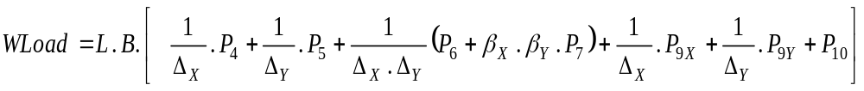
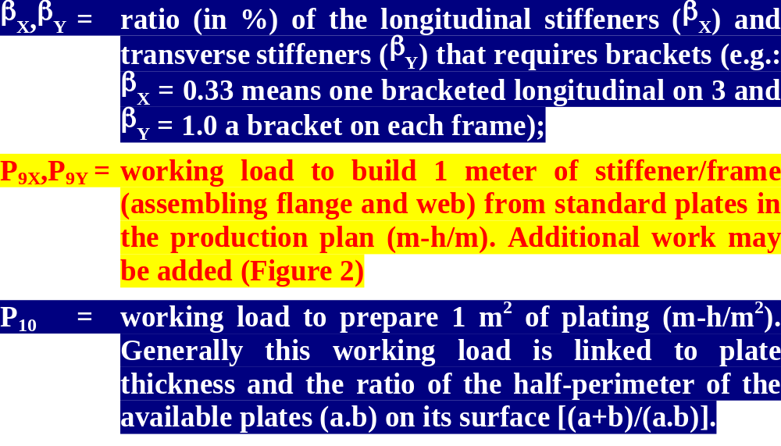

Slide 28
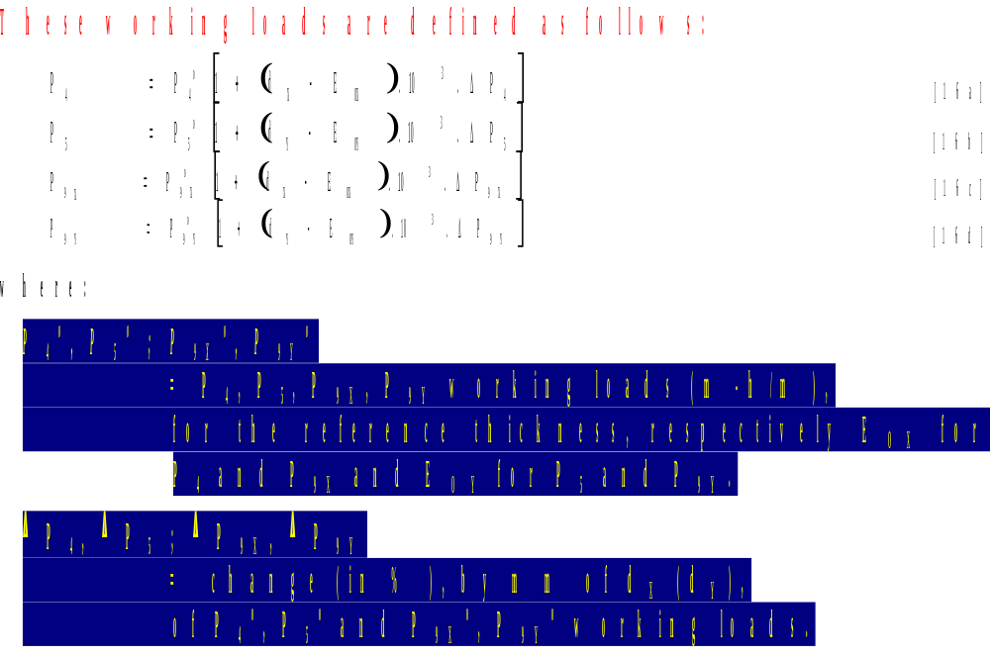

Slide 29
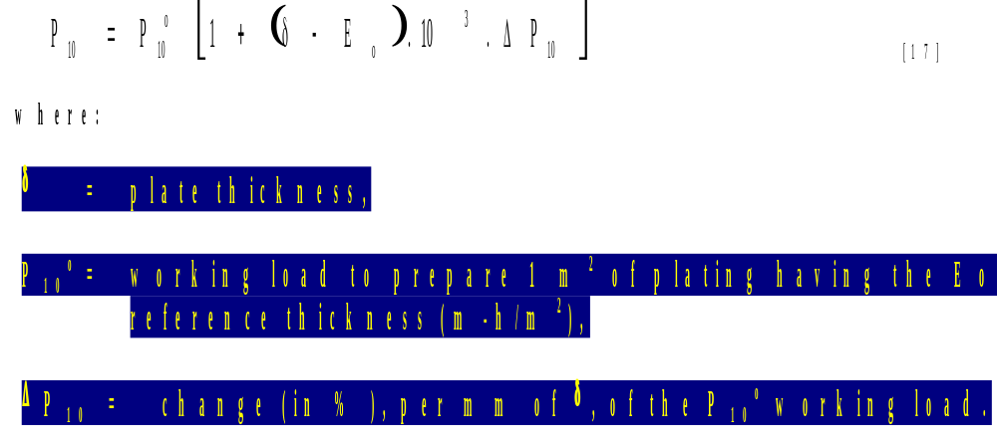

Slide 30
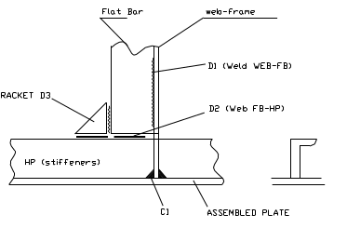
Additional works that can be considered:
• D1: welding of the flat-bars (FB) on webs
  (for instance web-frames on double bottom),
• D2: Welding of the flat-bars (FB) with the longitudinals,
• D3: Brackets between the flat-bars (FB) and the longitudinals.

